Slide 1
Publishing Article

Slide 2
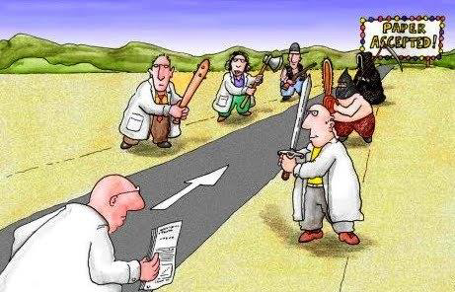
Research Publication
Research is not complete until the results have been peer reviewed and published.

Slide 3
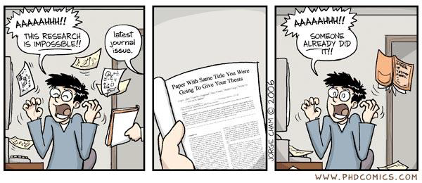
Publication ...
Before writing the paper, it is wise to check the published literature to see if there have been recent publications in this field.

Slide 4
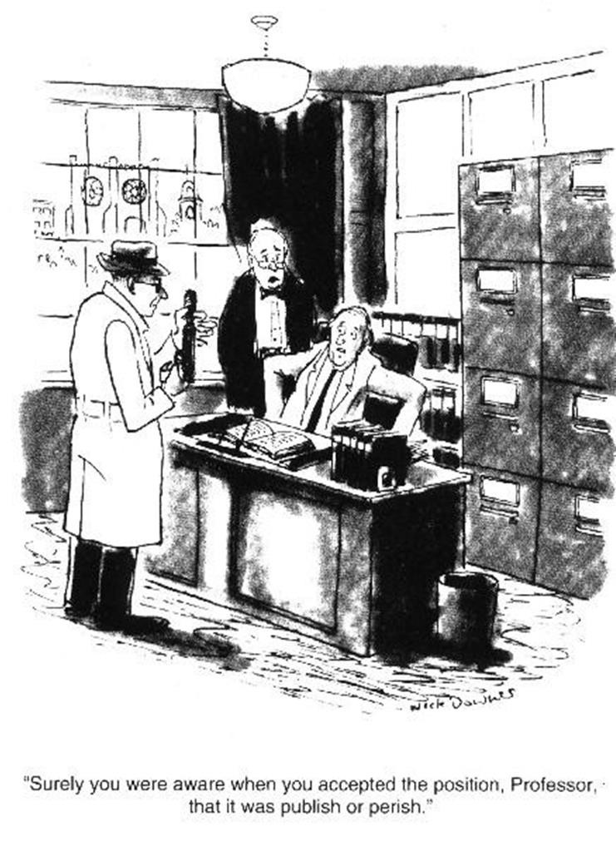
Motivation for Writing
Science includes the dissemination of knowledge
Ideally –
Every research needs good and proper documentation.
To share research results with other researchers.
To get views for improvement of your research.
to contribute to the advancement of knowledge

Slide 5
Motivation for Writing
Practically –
To get funding
To get recognition and promotion
To get a job
To obtain some form of degree.
To keep your job
Publish or Perish!

Slide 6
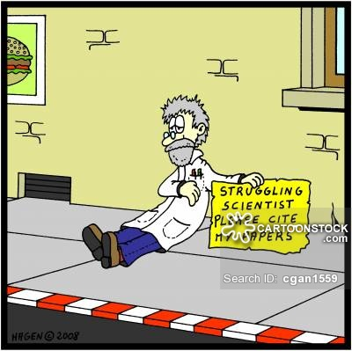
Motivation for Writing
When you should write a paper?
You should have something important enough to share with others
new ideas
new facts or data
intelligent reviews of old facts and ideas
Mature results
research milestone completed
Breakthrough
solves an open problem that many people have worked on
Ground-breaking
opens up a field/area that is not well explored

Slide 7
Motivation for Writing
When you should NOT write a paper?
Wrong reasons
want or need publications
increase publication count for fame
Peer pressure

Slide 8
What is a Technical Paper?
Technical paper is a brief and to-the-point document which describes a body of technical work
There are many types of technical papers
Review papers
Letters/short communications
Policy briefs / analyses
Research papers
Opinion pieces / perspectives
Case studies / reports
Thesis by publication
Book/book chapters
Conference papers/workshops

Slide 9
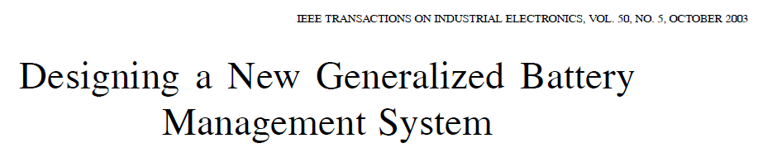
Types of Technical Papers
Regular/Original/Full Articles:
These should describe new and carefully confirmed findings, and experimental procedures should be given in sufficient detail for others to verify the work.

Slide 10
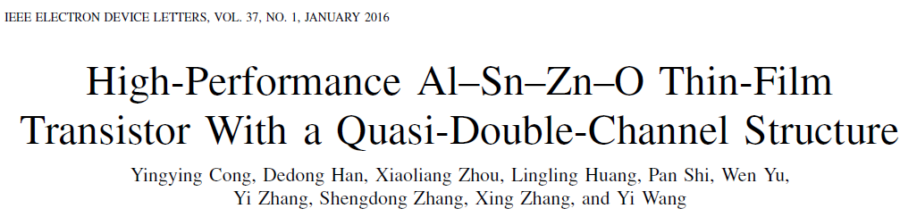
Types of Technical Papers…
Short Communications/Letters/Research Note:
suitable for recording the results of complete small investigations or giving details of new models or hypotheses, innovative methods, techniques or apparatus.
The style of main sections need not conform to that of full-length papers.

Slide 11
Conference Proceedings
Conference quality
Selection / refereeing process
Based on abstract only – not recommended
Based on full paper – necessary, in order to be recognized !
Sponsors
Sponsored by a prestigious society? IEEE, IFIP, IFAC, ACM, CIRP, ... If not, check it carefully !
Type of proceedings
CD-ROM or on-line (Cheap, shorter publication time)
Paper proceedings, published by organizers (Limited impact / limited availability)
Book, by main publisher or society (e.g. Springer, IEEE)
More prestigious, wider availability, included in index databases (e.g. Web of Science)

Slide 12
Conference Proceedings…
Benefits:
Shorter publication cycle < 1 year
Live exchange of ideas with other researchers
Some “scientific tourism”
Demerits:
Less prestigious,
even totally ignored in some forums
Costs money (conference fee, travelling)

Slide 13
Conference Purpose
Scientific conferences
High quality requirements, serious refereeing procedure
Recognized proceedings (typically book, indexed)
“Networking” conferences
The purpose is mainly to help finding partnerships and opportunities for new projects
Most presentations are invited talks
Rarely have formal proceedings
Example: many events promoted by the European Commission
“Dissemination” conferences
Mostly oriented towards dissemination to industry or society
Discussion of practical case studies
Low evaluation criteria, if any (frequently by abstract only)
Useful to find industrial partners
“Mercenary” conferences
The purpose is to generate revenues to their organizers
Almost no evaluation, large spectrum

Slide 14
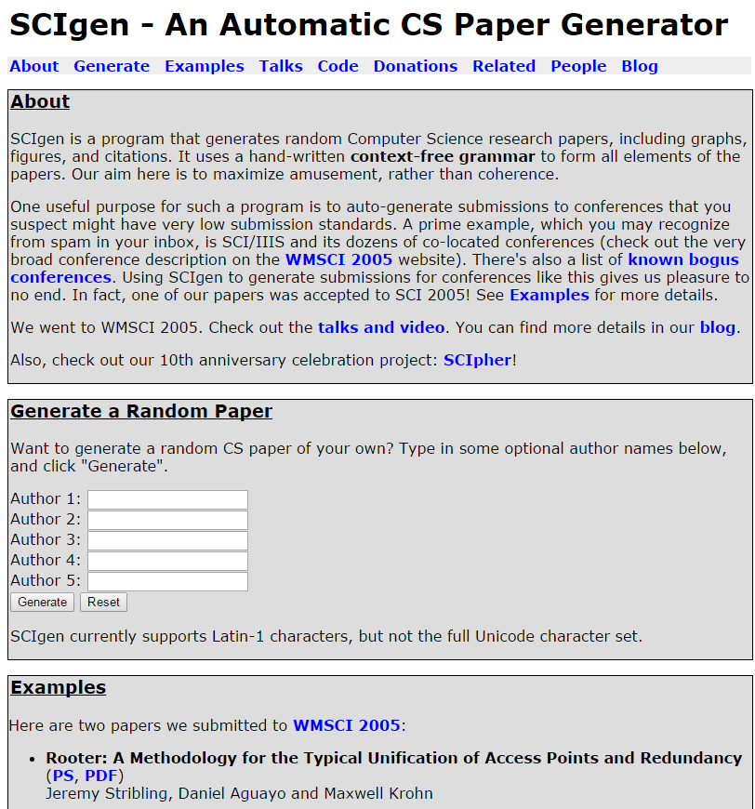
Bad Conference Example
Low quality/Fake conference
WMSCI 2005
(Organized by Prof. Nagib Callaos)
A randomly generated paper was accepted

Slide 15
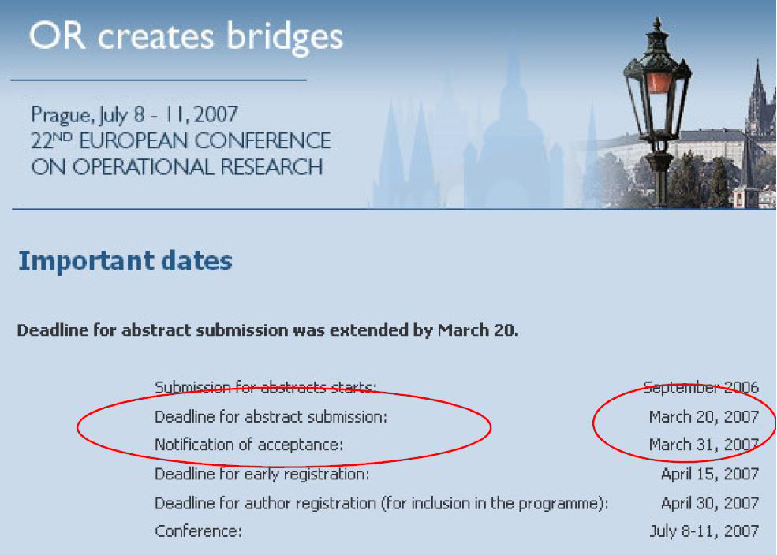
Bad Conference Example
No written papers were required
Only abstracts!

Slide 16
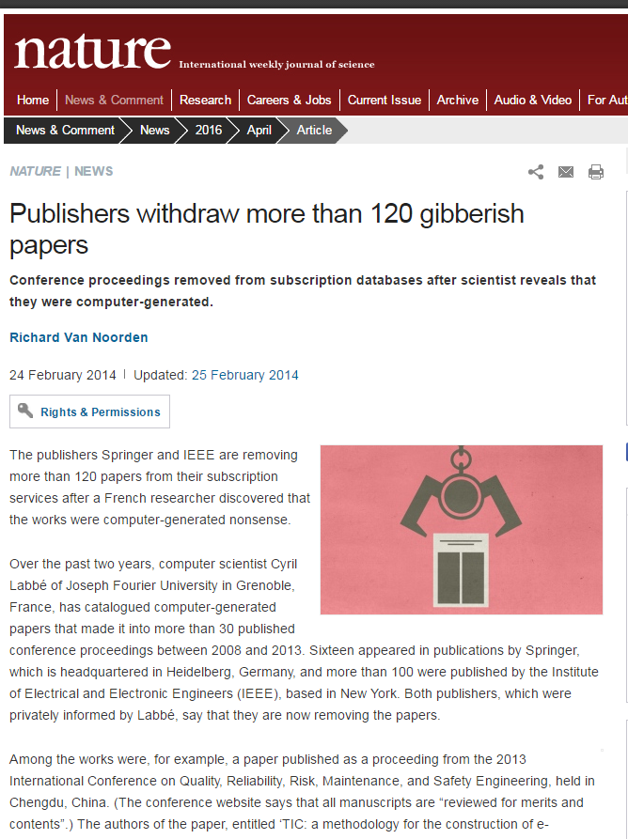
Bad Example... Even IEEE!
A fake paper accepted at the “2008 International Conference on Computer Science and Software Engineering”
World Scientific Conferences has the highest number of computer generated papers
Conferences by IEEE and Springer also contain fake papers.

Slide 17
Special Issues of Journal
Special issues are focused on one specific topic.
They are edited by Guest Editors
Typically have dedicated “Call for submissions”
.. and dedicated referees (other than the normal editorial board)
Many conferences are now editing special issues of journals in addition to the regular proceedings
Best papers of the conference are invited to submit an improved / extended version
The new version is evaluated again, but the success rate is much higher than with normal submissions
Being invited to a special issue is prestigious
Your paper is among the best in the conference.
The publication time can be shorter than with normal submissions
Overall this is a good combination: you get two publications and the feedback collected in the conference can help considerably improving the version for the journal.
Copyright issues may require substantial changes in the original paper.

Slide 18
Publication as Book Chapter
Most important - book quality
There are several cases ...
Books published by prestigious publishers or by unknown publishers? Books with evaluation by an editorial board or not?
How?
Submission with evaluation?
Similar to a conference (or journal) By invitation ?
If the overall quality of the book is good and the editors are recognized authorities in the field, then it is prestigious
HOWEVER:
The rules here are not as clear as in the case of conferences and journals ...
The evaluation panels and funding agencies do not have clear rules to assess this kind of publications.
The –life of a book is usually lower than the life of a journal. Better to publish the original ideas in a journal first.

Slide 19
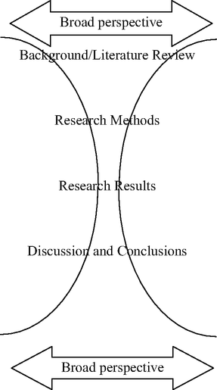
Structure of a Scientific/Engineering Paper
The change from a broad perspective in literature review
A narrow description of the experimental work conducted and its interpretation, and
Conclude with a broad perspective to explain how the results impact on the current body of knowledge.
This template should be used for all publications including journal papers, theses, abstracts, presentations, posters.

Slide 20
Elements of a Technical Paper
Title of the paper
Authors, designations, and addresses
Abstract (100 to 300 words)
Keywords
Sections describing the work
Introduction (Background)
Previous Work (Literature Survey)
Proposed Work (Algorithm, Design, Methodology)
Analysis (Complexity Analysis, Quantitative Analysis, Statistical Analysis, …)
Implementation, Results and Discussions
Conclusions

Slide 21
Writing Guidelines
Standard Terms:
The paper must be prepared accordingly based on the target audience.
The audience can be assumed to consist of students, professors and research workers in the field or discipline.
Use terminology that is well known to the audience and appropriate to their level of education and disciplinary background
Defining Symbols & Acronyms:
Use symbols in equations that are consistent with textbooks and other papers.
All symbols in an equation must be identified in the text immediately before or immediately after the first equation that uses them.
The names of commercial products should not be used in the main text
All acronyms should be defined as a set of initials immediately following the first mention in the text.

Slide 22
Figures & Equations
Figure:
All figures must be numbered.
Figures are referenced in the main text.
Don’t start a sentence with an abbreviation: Figure vs. Fig.
Figures have captions which are self-explanatory (i.e. do not require the audience to read the main text to discover the meaning and importance of the graph).
If there is more than one line on the same plot then these lines can be distinguished using a legend or other labels on the graph.
Equations:
All equations must be numbered.
All symbols in the equations must be defined in the text close to the equation where the symbols are first used.
All symbols must be unique, that is, a symbol must never be used to represent more than one quantity or variable.

Slide 23
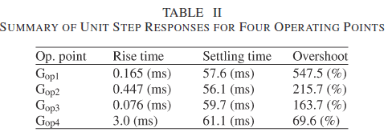
tables
Number all the tables
Provide captions for all tables
Refer to each table in the text.
Table II illustrates the performance of unit step response at the four operating points.

Slide 24

Title
Title must be unique and sufficiently descriptive to inform the readership of the research direction and field
Make it short but meaningful and reflective of the research work
Avoid abbreviations and very long titles
TITLE PAGE
Choice of Title
Description of major conclusion
Authors’ Names
Check instructions/format
Footnotes/Symbols
Author for correspondence
Key words

Slide 25
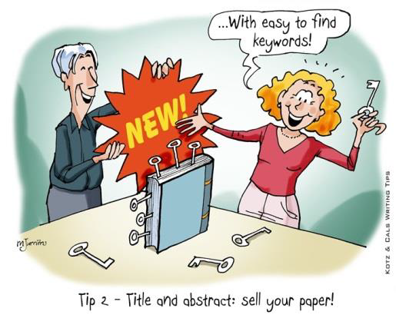
Keywords
The keywords included in the paper are important:
used by web-based search engines so that this new paper will be readily found by the appropriate readership
to select reviewers.
Inappropriate keywords will result in the paper being sent to reviewers who might not be experts in the field.
The possible rejection of the paper because the reviewers are not experts in this specific field of research
The acceptance of the paper with major flaws that might have to be retracted later;
Lengthy delays as more and more nominated referees refuse to review the paper on the basis that it is outside their research field.

Slide 26
Abstract
It is a brief account of the paper’s relevant points – it is a summary of the research
Highlight the problem and principal results
Must bring out the novelty of your work
No references, equations, formulas
It must stand alone without reference to text body
Avoid: “In this paper...”
Must be brief (100 to 300 words). Length and format are usually specified for a particular journal.
Sentence One: expand on the title. The first line in the abstract indicates the main contribution of the paper.
Sentence Two: why the work was done
Mention the method (no need to elaborate) used in the paper. What is the purpose of the method?
Is there any real-time implementation? If so, mention in brief how is it implemented?
Mention about the investigation and the results (simulation and experimental, including numerical results and the statistical strength of the results) of the proposed method. What is achieved from the results?
Two sentences outline how these results and conclusions impact on the research field.

Slide 27
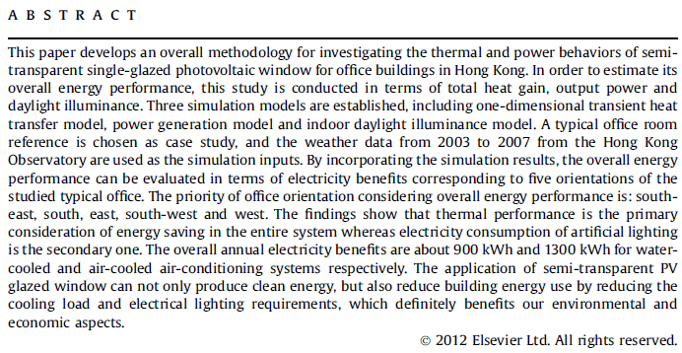
Abstract: An Example

Slide 28
Abstract…
Background/Main contribution:
The problem:
The method and its purpose:
The results:
Conclusion

Slide 29
Paper Sections & Subsections
1. Introduction
1.1 Problem Description
1.2 Organization of the paper
e.g. In Section 2, we summarize the previous work in this area. In Section 3, we present a new algorithm for …
2. Design of proposed method
2.1 Operating states
2.2 Control method
3. Experimental Implementation
4. Results and Discussions
5. Conclusions
Acknowledgements
References

Slide 30
Introduction
Beginning part should be the introduction about the current topic. Then mention why the current area is important.
Literature search and motivation of the work should be presented in this section.
Provide a literature review of similar research in the field- you can start of by giving a general literature review of similar research, then focus on those that more related to your research work – references are very much required here.
Identify and Highlight their limitations (as much as possible)
Mention the work that has already been reported and what has not been done in this area to improve the performance of the reported work? That motivates you to do the current work.
Write a brief account of your proposed technique and how the limitations as identified can be overcome

